Slide 1
CEYLINCO GENERAL INSURANCE LIMITED

Slide 2
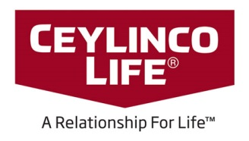
SECTORS OF CEYLINCO GROUP
CEG Education Holdings (Pvt) Ltd
INSURANCE
POWER GENERATION
EDUCATION
HEALTH CARE
DEVELOPMENT BANKING
Ceylinco General Insurance Limited
Energy Generators (Pvt) Ltd
Citizens Development Business Finance PLC
International College of Business and Technology Ltd
Sri Lanka’s oldest and most trusted market leader in the Insurance industry, forging ahead with Innovation.
Financial Power House that will foster entrepreneurial innovation and workmanship towards building up our nation’s economy to make sustained gains in living standards of Sri Lankans.
ICBT Infotech (Pvt) Ltd
CEC Events (Pvt) Ltd
Energy Lanka Holdings Ltd
Net Assist (Pvt) Ltd
Ceylinco Healthcare Services Ltd
Ceylinco Life Insurance Limited
ANC Modern Montessori International (Pvt) Ltd
Cey Hydro Developers (Pvt) Ltd
Ceylinco Investcorp (Pvt) Ltd
Ceylinco Life is Sri Lanka’s largest and undisputed leader in life insurance. Going from strength to strength with Innovative products and services.
American Education Center Ltd
ANC Education Holding Ltd
Ceypower Cascades (Pvt) Ltd
Wycherely International School (Pvt) Ltd
Regent International (Pvt) Ltd.

Slide 3
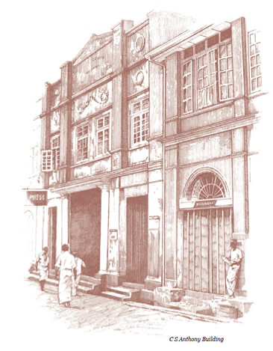
HISTORY OF CEYLINCO INSURANCE
1939
Commenced Business in 1939 as
CEYL
IN
CEYLON INSURANCE COMPANY
CO
1987
Company operations was
stopped due to Nationalization
of insurance industry in Sri Lanka
in 1962
1962
After the denationalization in 1987
The company re commenced as
CEYLINCO INSURANCE COMPANY LTD

Slide 4
INSURANCE MARKET OVERVIEW
Population : 21 Million
Insurance Market : $ 1 Billion
Ceylinco Insurance : Ranked # 1 in Sri Lanka
Ceylinco Insurance PLC Premium : $ 211 Million
General Insurance : $ 105 Million

Slide 5
CEYLINCO GENERAL - PROFILE
Presence (Sri Lanka) : 525 Branches
(Overseas) : 8 Countries
Total Employees : 3500
Sales Team : 1800
Assessors/Engineers : 180
Total Claims Paid (2018) : $ 50 Million
Service : 24/7

Slide 6
PREMIUM INCOME
MILLIION ($)
Notes:
All barse onse

Slide 7
Kuwait
Dubai
Subsidiary
Maldives
Associate
Nepal
Overseas Presence
Nepal
Bahrain
Oman
Strategic Alliance
Dubai
Bahrain
Qatar
Kuwait
Oman
Mauritius
Qatar
Maldives
Mauritius

Slide 8
NETWORK PARTNER
AIG – American Insurance Group
REINSURANCE PARTNERS
Swiss RE Switzerland
Munich RE Germany
Hannover RE Germany
SCORE RE France
Toa RE Japan
Lloyds of London UK
China RE China
REINSURANCE

Slide 9
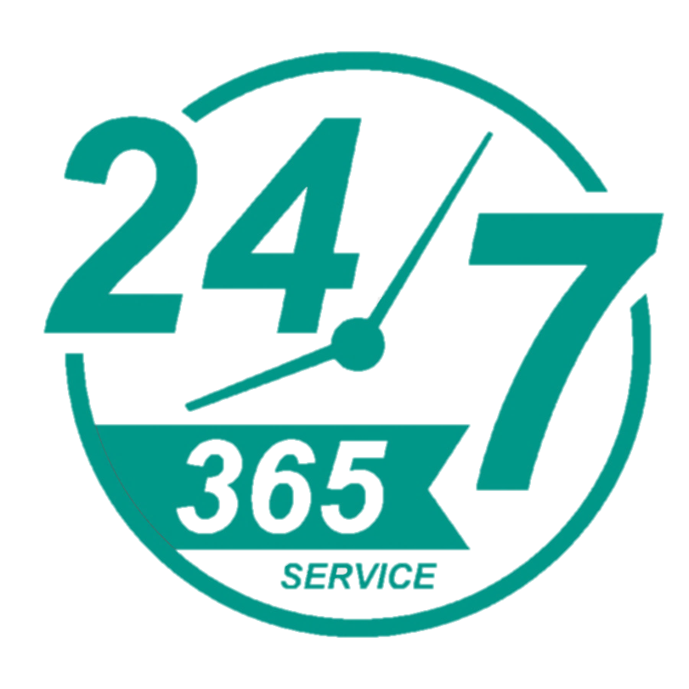
CEYLINCO INSURANCE FACTS:
Original Registration: 1939 as Ceylon Insurance Company. Sri Lankas #1 Insurance Company
Market leader for the insurance industry for past 8 years
Ceylinco Insurance possesses the largest insurance network in the country
We have a team of Engineers/Assessors located island wide working round the clock ready to attend to any emergency
LARGEST NETWORK
Market
No
1
Registered
No
1

Slide 10
AWARDS & ACCOLADES
People's Insurance Company of the year (POP Awards)
2006 to 2019
Only insurance company in 'Business Today Top 10' - 2018
Gold Award at the National Business Excellence Awards (Year - 2008, 2010, 2011, 2012 & 2013)
No 1 Service Brand in Sri Lanka - 2004, 2005 & 2008
Brand of the year – 2005
Innovative Brand in Sri Lanka – 2005

Slide 11
Motor Insurance
INSURANCE
PRODUCTS
Fire Insurance
Shop Insurance
Miscellaneous Insurance
Travel Insurance

Slide 12
Engineering Insurance
INSURANCE
PRODUCTS
Title Insurance
Marine Insurance
Health Insurance
Personal Insurance

Slide 13
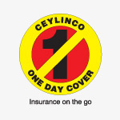
PERSONAL INSURANCE
TYPE OF PRODUCTS

Slide 14
Jaffna
Fully owned subsidiary of Ceylinco Insurance PLC, which dominates the highest share price in the Colombo stock exchange
Regulated by Insurance Regulatory commission of Sri Lanka
Maintaines highly adequate capital ratios
Solvency Margin much more than required by the regulator
Market Leader and most sought after General Insurance Company in Sri Lanka
Reinsurance agreements with highly rated and leading Reinsurers
525 Branches and a team of Engineers /Assessors located Island wide
WHY CEYLINCO GENERAL INSURANCE
Network
Stability & Capacity
Polonnaruwa
Batticaloa
Kandy
Colombo
Galle
Matara
Notes:
Kandy , jafna, Polonnaruwa, mathara , galle, Colombo , batty, wich dominates add an s

Slide 15
KEY
INFRASTRUCTURE
&
DEVELOPMENT PROJECTS
Southern Highway Section 1-3 USD 1.1 Bn
Outer Circular Highway USD 0.5 Bn
Colombo Port Expansion Project USD 225 Mn
Havelock City USD 111 Mn
Upper Kotmale Hydro Power Project USD 100 Mn
Colombo - Katunayake Express Way USD 53 Mn
Waste Water Project USD 44 Mn
Tunnel Project USD 28 Mn
Design, Construction and Commissioning
of Housing Units - Maldives USD 21 Mn
Southern Transport Development USD 5.5 Mn

Slide 16
Thank You

